Slide 1

BIG BASKET
EXPLORATORY DATA ANALYSIS of
Big Basket
DATA ANALYSIS by
Lucky Bisht

Slide 2

ABOUT BIG BASKET
Big Basket is one of India’s leading online grocery platforms, offering a wide variety of fresh produce, pantry staples, household essentials, and personal care products. Founded in 2011, the company revolutionized grocery shopping by providing convenient doorstep delivery with a user-friendly app and website. Big Basket partners with farmers and suppliers to ensure high-quality products and offers services in multiple cities across India. Customers can choose from an extensive catalog that includes fresh fruits, vegetables, dairy, organic items, and more. With features like scheduled delivery, attractive discounts, and subscription plans, Big Basket has become a trusted name in online grocery shopping.
Big Basket was founded in 2011 in Bangalore by Hari Menon and his team, including veterans of Fabmart, one of India’s earliest e-commerce ventures. Initially focused on solving challenges in grocery delivery, the company expanded rapidly, leveraging technology and efficient logistics to become India’s largest online grocery platform by the late 2010s
Over the years, despite facing competition from emerging player like Jio Mart and Blinkit, Big Basket has sustain its dominance, leveraging its expensive customers base and adapt transition to online retail.

Slide 3
INTRODUCTION
Online grocery shopping has transformed daily essentials purchasing, with Big Basket leading the sector since 2011. As India’s largest online grocery platform, it has sustained its dominance despite growing competition from players like Blinkit by effectively utilizing its vast customer base and adapting to the evolving e-commerce landscape.
The project focuses on analyzing Big Basket's data to gain insights into customer behavior, product performance, and market trends. By exploring sales patterns, inventory management, and customer preferences, the analysis aims to provide actionable insights for improving operations, optimizing resources, and enhancing the overall customer experience for the online grocery platform.

Slide 4
OBJECTIVE OF THE PROJECT
Data Understanding and Cleaning:
Understand and clean the Big Basket product data, handling missing values
and outliers.
Trend Analysis:
Analyze the sales patterns of different product categories like groceries,
personal care, and home products.
Price and Rating Insights:
Analyze the relationship between product prices and customer ratings.
Data Visualization:
Visually represent the data using charts and graphs to highlight key patterns like
top-selling products, category performance, and seasonal trends.
Market Basket Analysis:
Identify frequent product combinations that customers purchase together.
Business Insights:
Provide valuable business insights for Big Basket to improve sales and
customer satisfaction.

Slide 5
STEPS TO FOLLOW:
Step 1: Load Data Set.
Step 2: Use head function to look for first 12 rows.
Step 3: Get Description of the data in the Data Frame.
Step 4: Find Information about the Data Frame.
Step 5: Find out Top & least sold products.
Step 6: Measuring discount on a certain item.
Step 7: Find out the Missing Values from the Dataset.
Step 8: Find out the outliers from the dataset according to the columns
and fill them with the mean.
Step 9: Create Plots or visualizations.

Slide 6




Step 1: Loading the DATASET
Here I am using Google colab Notebook for work.
The dataset has been imported from Google Drive.
As we begin our Exploratory Data Analysis (EDA). I’ve named the dataset “df”.
This dataset has 27555 rows and 10 columns.
For cleaning the Dataset , I used (python) libraries like Numpy, Pandas, Matplotlib, Plotly and seaborn.
Duplicate entries that were found have also been removed from the dataset.
#Dropping the duplicate entries

Slide 7
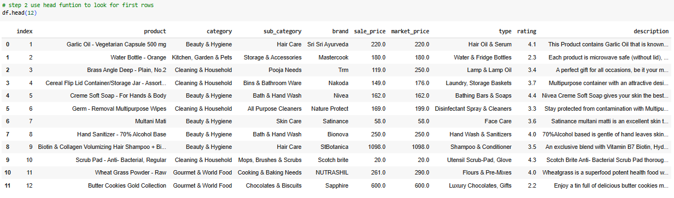
STEP 2: USE HEAD FUNCTION TO LOOK FOR FIRST ROWS:

Slide 8
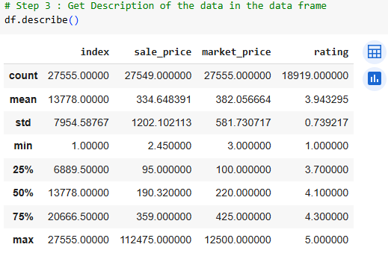
Step 3: Get Description of the data in the Data Frame
The table showing in this page provides descriptive statistics for numerical columns in the Data Frame, including:
Count: Number of non – null entries in each column.
Mean: Average value of the column.
Std: Standard deviation, representing variability.
Min,25%, 50%, 75%, max: Minimum value, 25th percentile, median, 75th percentile, and maximum value.
Here’s a description of the columns from the table:
Index
Sale price
Market price
rating

Slide 9
Index:
Likely a unique identifier for each row in the dataset.
Example: Row number or IDs.
It doesn’t hold much statistical relevance but is used for indexing.
Sale price:
Sale price represent the actual selling price of the product is being sold.
It is Useful for analyzing pricing strategies and customer trends.
Market price:
Market price Represents the standard market price of the product.
Comparing this with sale price helps to identify discounts per product.
Rating:
Represents the product’s rating, likely based on customer feedback.
A range from 1 (lowest) to 5 (highest) is common for ratings.

Slide 10
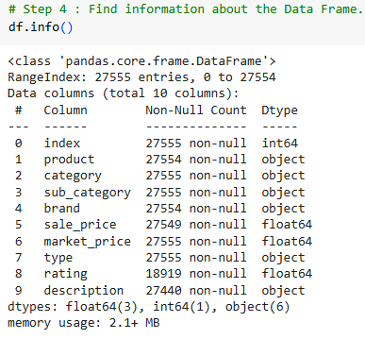
STEP 4: Find Information about the Data Frame.
Data Frame Shape: The Data Frame has 27,555 rows and 10 columns.
Memory usage: Approximately 2.1+ MB.
Columns Details:
Index:
non- null values: 27,555.
Data type: int64
2. Product:
Non-null values: 27,555 (1 missing value).
Data type: object (likely strings).

Slide 11
3. Category:
Non-null values: 27,555.
Data type: object.
4. Sub category:
Non-null values:27,555.
Data type: object.
5. Brand:
Non-null values: 27,554(1 missing value).
Data type: float64
6. Sale price:
Non-null values: 27549 (6 missing values.)
Data types: float64
7. Market price:
Non-null values:27,555.
Data type: float64
8. Type:
Non-nulls values: 27,555.
Data type: object
9. Rating:
Non-null values: 18,919 (many missing values).
Data types: float64
10. Description:
Non-null values: 27,440 (115 missing values).
Data type: object
Observations:
Columns like product, brand, sale price, rating, and description contain missing values.
The data types include integer (int64), floating-point numbers (float64), and objects (likely strings or mixed types.)

Slide 12
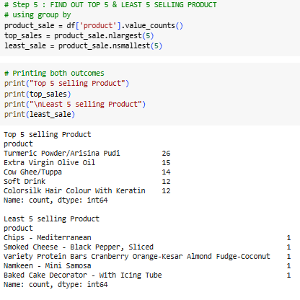
Step 5: Find out Top 5 & least 5 selling products.
Key insight:
Group products by occurrence:
product _ sale = df[‘product’].value _ counts()
Groups the dataset column ‘product’ and counts how many times each product appears.
Find Top 5 selling products:
Top _ sale = product _ sale.nlargest(5)
Finds the 5 products with the highest counts.
Find Least 5 selling Products:
Least _ sale = product _sale.nsmallest(5)
Finds the 5 product with the lowest counts.

Slide 13
4. Print Result:
Prints the names of the Top 5 and Least 5 Products along with their counts.
Output:
Top 5 Selling Products by count:
Turmeric Powder/Arisina Pudi: 26
Extra virgin olive oil: 15
Cow Ghee/Tupppa: 14
Soft Drink: 12
Colorsilk Hair colour with Keratin: 12
Least 5 Selling Products by count:
Chips – Mediterranean: 1
Smoked Cheese – Black Pepper , Sliced: 1
Variety Protein Bars Cranberry Orange – Kesar Almond Fudge-coconut: 1
Namkeen – Mini Samosa: 1
Baked Cake Decorator – With Icing Tube: 1

Slide 14
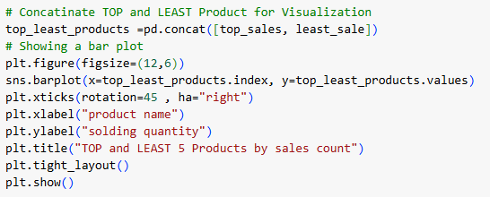
This is the Visual representation of the Top and least sold products.

Slide 15
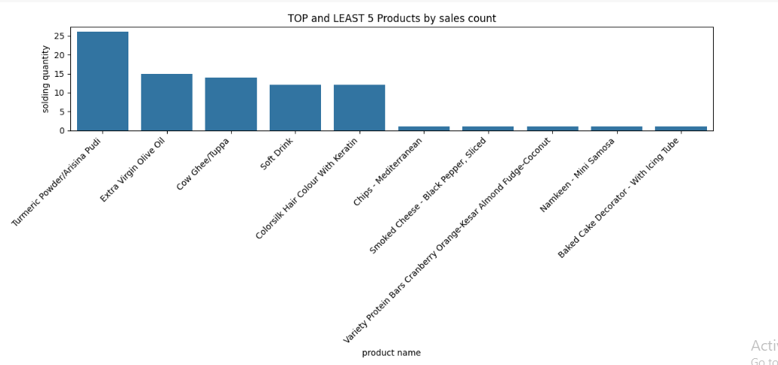
This chart shows the top 5 and Least 5 selling products based on the number of many times they were sold. Turmeric Powder / Asthma Pudi is the highest – selling product, while the least sold products include items like Baked cake decorator and Mini Samosa.

Slide 16
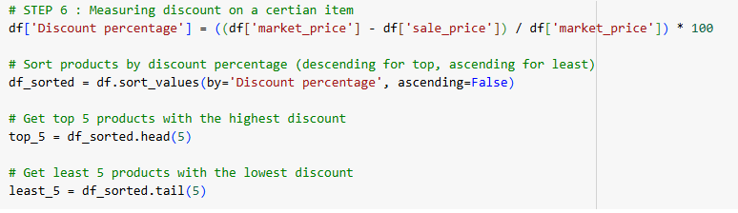

Step 6: Measuring discount on a certain item.
Key Insights:
Discount calculations:
The discount percentage is calculated using the formula:

Slide 17
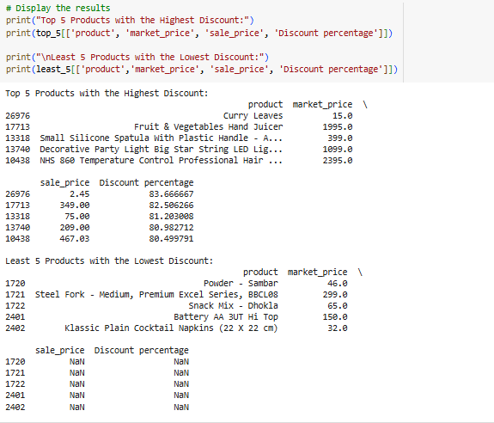
1. Top 5 Discounted Records :
Top 5 Records: the short function is used for shorting the discount percentage column according to discount in ascending order .

Slide 18
2. Least 5 Record :
Least 5 Records: Again I used here the short function for getting least discounted products which is showing in the above.
3. Observations:
Top Discounts: The highest discount percentage exceeds 80% for some products, such as the "NHS 860 Temperature Control Professional Hair" with a discount of 80.492717% and the "Decorative Party Light Big Star" with 80.992112%.
Curry Leaves: Despite its low market price (15.0), Curry Leaves has a high discount percentage of 83.666667%, highlighting that low-priced items may still have substantial discounts.
Pricing: The sale price values for the top 5 products with the highest discounts range between 2.45 and 467.00, indicating significant reductions from their market prices.
Least Discounts Issue: For the least 5 products with the lowest discounts, the sale price and Discount percentage columns are displaying NaN values, which suggests missing or incorrect data for those items.

Slide 19
Product Variety: Products range from food items like "Curry Leaves" to appliances like "Fruit & Vegetables
Hand Juicer" and tools like "Spatula," reflecting diverse categories.
6. Missing Discount Info: Items like "Powder - Sambar" and "Steel Fork" appear in the "Lowest Discount“
section, but their corresponding discounts are not shown, which likely points to an issue in data filtering
calculations.
Data Gaps: The occurrence of NaN values in the "sale price" and "Discount percentage" columns may result
from incomplete data or errors during calculations.
Extreme Differences: While the highest discounts exceed 80%, the lowest discounts might be very minor, but
due to missing data (NaN), we cannot confirm exact values.
Format Consistency: The table displays well-structured results for the top 5 discounts, but the presence of
NaN values in the "least discounts" section hampers clarity and usability.
10. Conclusion: The output highlights discrepancies in the least discount section and showcases products with
very steep discounts in the top 5 list. Data cleaning and validation are needed for the "least discount" items
to ensure accurate representation.

Slide 20
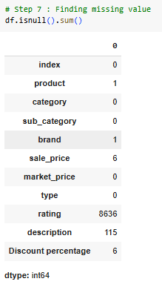
Step 7: Find out the Missing Values from the Dataset.
Key Insights:
1. Missing Values Identified:
Columns with missing data:
Product: 1 missing value.
Brand: 1 missing value.
Sale _ price: 6 missing values.
Rating: 8636 missing values (significant).
Description: 115 missing values.
Discount: 6 missing values.
Other columns have no missing values.
2. Action Required:
Handling missing values appropriately (e.g., fill, drop, or analyse impact).
Focusing more on rating and description as they have many missing values.

Slide 21
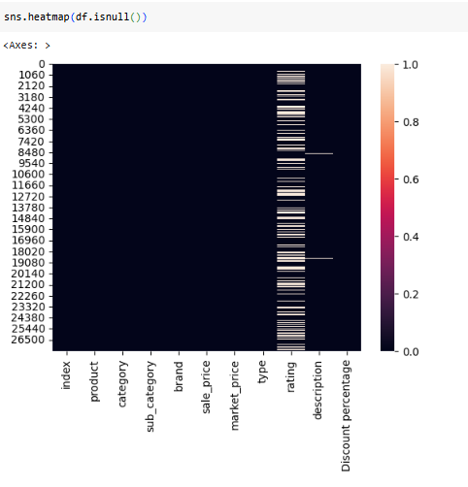
This code is to draw the Heatmap of the missing values in the dataset:
The heatmap in the image shows missing values in the dataset using
sns.heatmap(df.isnull()). Key insights are:
1. White Lines: Represent rows where data is missing (NaN values) in specific columns.
2. Black Areas: Indicate No missing values in those regions.
3. Columns Affected: Specific columns with more white lines have more missing data.
4. Density of Missing Values: The presence of many white lines suggests significant missing data in parts of the dataset.
This visualization helps in identifying which columns or rows need attention for data cleaning.

Slide 22
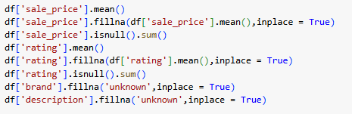
Now lets replace the missing values:
Key insights:
Replaced Missing sale _ price and rating:
Missing values in the sale _ price and rating columns are replaced with their respective mean values.

Slide 23
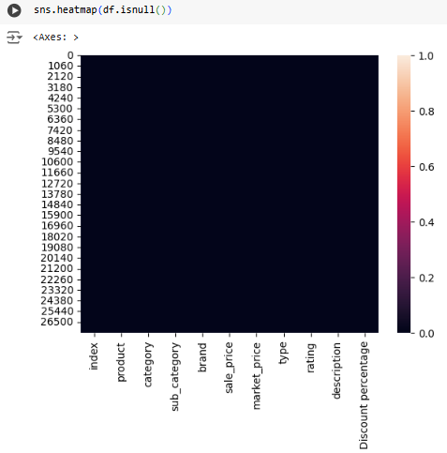
2. Replace Missing brand and description:
Missing values in the brand and description columns are filled with the word "unknown".
3. Outcome:
The updated heatmap (sns.heatmap(df.isnull())) now shows no white lines, meaning all missing values have been successfully filled.

Slide 24
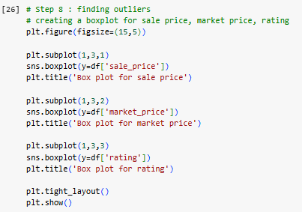
Step 8: Find out the outliers from the dataset according to the columns and fill them with the mean:

Slide 25
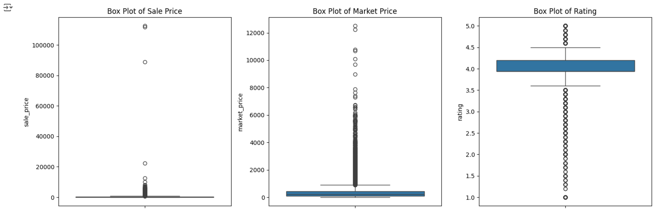
Key insights:
The provided boxplots visualize the distributions of three features:
Sale _ price, market _ price, and rating. Here are the key insights:

Slide 26
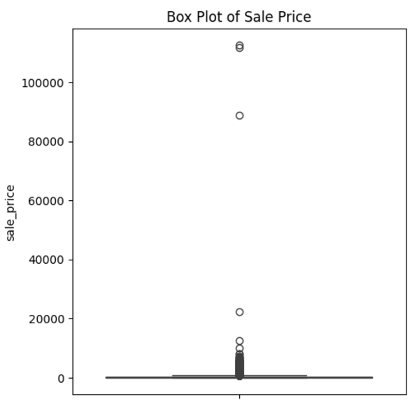
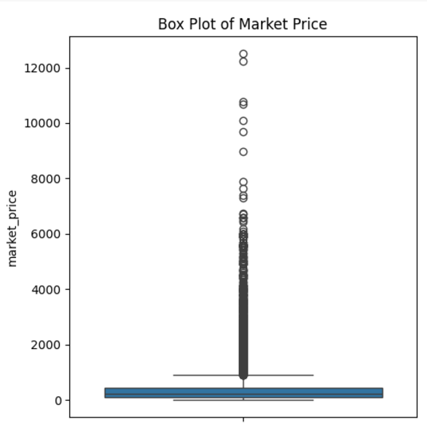
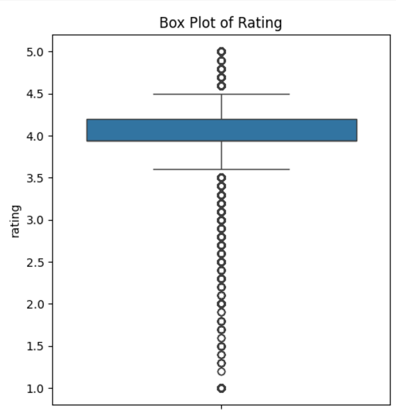
1.
2.
3.
Box Plot of Sale Price: The sale price shows significant variability with extreme outliers beyond 100,000, indicating a highly skewed distribution.
Box Plot of Market Price: Market price also has outliers but is less extreme, with most values concentrated below 2,000, suggesting tighter variability.
Box Plot of Rating: Ratings are mostly centered around 4, with minimal variation and a few outliers below 3, showing a generally positive trend.

Slide 27
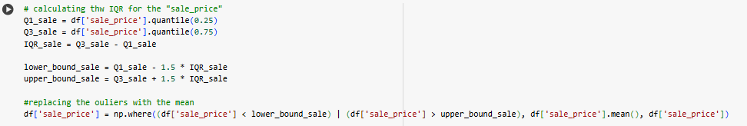
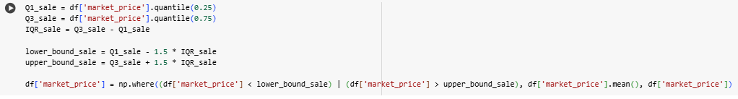
As we can see there are outliers in the sale price, market price and the ratings. So, lets replace it with the mean.

Slide 28
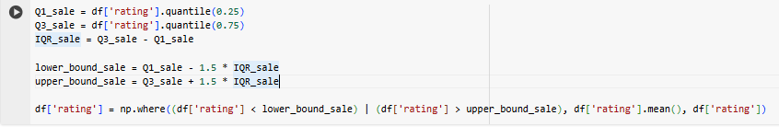
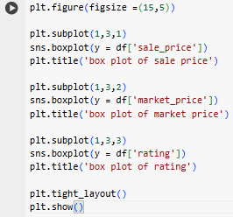
Since we have removed the outliers lets see the box plot now:

Slide 29
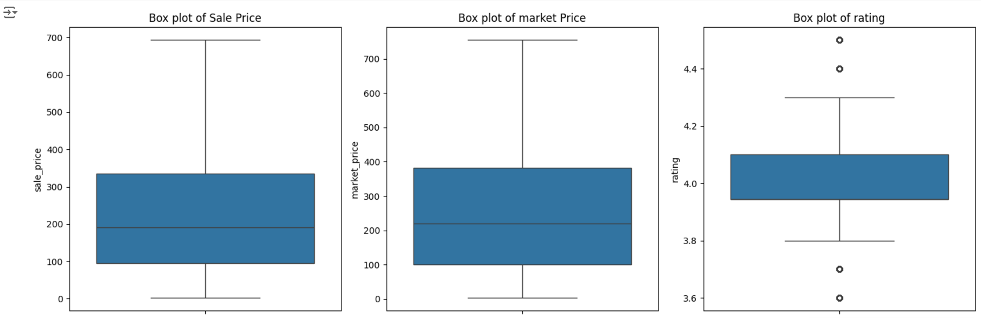
Key insights:
Detailed Insights from the slides:

Slide 30
Outlier Identification and Treatment:
For Sale _ price, Market _ price, and Rating, outliers were identified using the Interquartile Range (IQR) method:
IQR calculation:
IQR = Q3 – Q1, where Q1 is the 25th percentile and Q3 is the 75th percentile.
Bounds:
Outliers are values less than Q1 – 1.5 * IQR
Or greater than Q3 + 1.5 * IQR.
Outliers were handled by replacing them with the mean value of their respective columns. This approach maintains the overall structure of the data while minimizing the impact of outliers on the analysis.
2. Post - Outlier Data visualization:
Box Plot Analysis:
The Box plots show how the data looks after outliers have been replaced:
Sale Price: The data now has a cleaner range with fewer extreme values, and most values are concentrated in the lower range.
Market Price: Similar to sale _ price, the variability is reduced, making the data more stable for analysis.
Rating: Ratings exhibit a narrow spread, suggesting most products have ratings within a consistent range.

Slide 31
3. Key Observations:
Before vs. After Outliers: Handling outliers improves data quality and ensures the dataset is more reliable for statistical analysis or modeling.
Uniformity: Replacing outliers with the mean avoids sudden spikes or dips, helping maintain uniformity.
Cleaner Box Plots: The updated box plots show a reduced range, with values now aligning better within the interquartile range.
4. Impact on Data Analysis:
The removal of extreme outliers enhances the dataset's integrity and ensures the results of any future analysis (e.g., regression models, predictions) will not be disproportionately influenced by outliers.
In summary, this process makes the data consistent, reliable, and ready for further insights or predictive modeling.

Slide 32
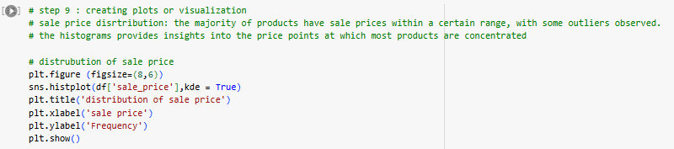
Step 9: Create Plots or visualizations:
Key Insights:
This histogram shows the distribution of sale prices with an overlayed density curve to highlight the trends. Here's an analysis:
1. Right-Skewed Distribution: The distribution is positively skewed, with most sale prices concentrated between 0 and 400, and a long tail extending to higher values.

Slide 33
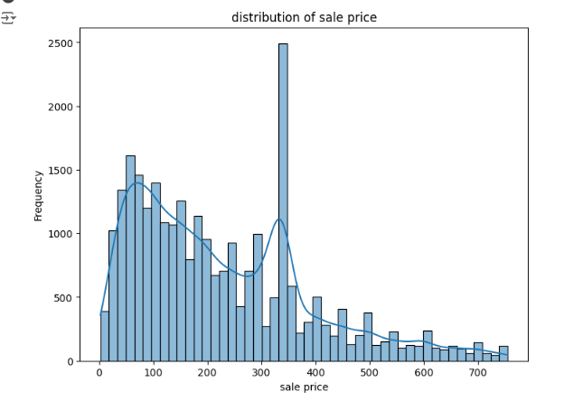
Peak Around 300: There is a noticeable spike at approximately 300, indicating a common price point where a large number of sales occur.
Frequency Decreases with Higher Prices: As sale prices increase beyond 400, the frequency drops significantly, indicating that higher sale prices are less common.
This pattern indicates that affordable price ranges drive
most of the sales, with fewer transactions at premium
price points
This analysis helps in understanding the general pricing trends and identifying anomalies in the data.

Slide 34
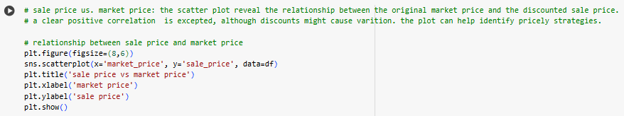
Key insights:
The scatter plot illustrates the relationship between the Sale Price and Market Price of products. Here are the key insights:
Positive correlation: There is a clear positive correlation between the sale price and market price, as most points align along an upward – sloping trend. This indicates that higher market prices generally lead to higher sale prices.

Slide 35
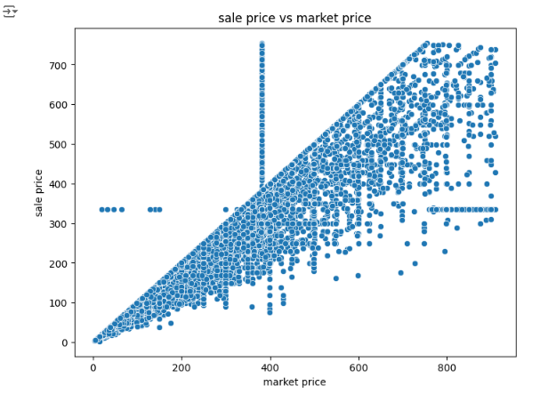
Positive Correlation: The sale price and market price show a strong positive correlation, as most points follow an upward trend, indicating that higher market prices lead to higher sale prices.
Discounts: Points below the diagonal (y = x) suggest that some products are sold at discounts relative to their market prices.
Clusters: A dense cluster appears in the lower price range, showing that most products fall within this pricing category.
Outliers: A few scattered points deviate significantly from the trend, representing products with unique pricing strategies (e.g., unusually high or low sale prices compared to market prices).
This visualization offers insights into pricing trends
and the effects of discounts on sales.

Slide 36
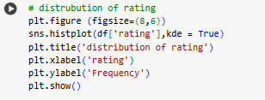
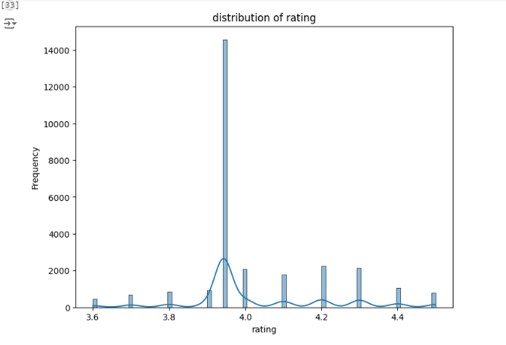

Slide 37
Key insights:
This Visualization shows the distribution of product ratings.. Here are the Key insights:
Central Tendency: The distribution is highly centered around a rating of 4.0, indicating this is the most common rating.
Peak Frequency: The frequency at 4.0 is significantly higher than other ratings, suggesting a high concentration of ratings at this value.
Spread: The distribution shows limited variation, with most ratings falling between 3.6 and 4.4.
Outliers or Patterns: Minor peaks are visible at intervals, possibly due to rounding or standard rating practices
Insights: The pattern suggests a strong bias towards average to above-average ratings, indicating a tendency for users to rate favorably.

Slide 38
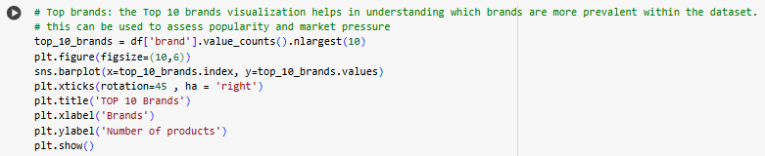
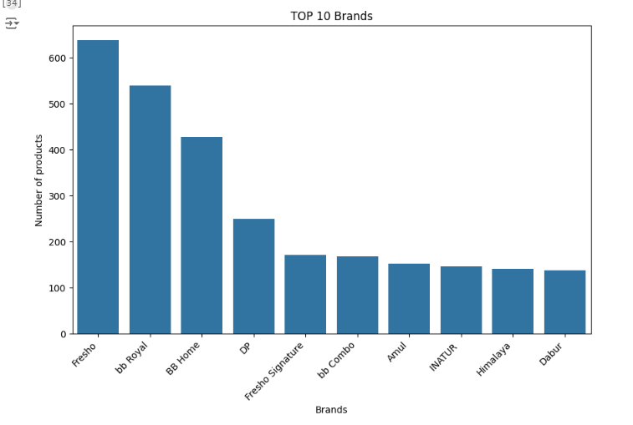

Slide 39
Key insights:
The Provided visualization shows the top 10 brands based on the number of products in the dataset. Here are the key insights:
Top Brand: "Fresho" leads with the highest number of products, exceeding 600.
Second Place: "bb Royal" follows closely as the second most represented brand.
Mid-tier Brands: "BB Home" and "DP" rank third and fourth, with a noticeable drop compared to the top two brands.
Lower Brands: "Amul," "INATUR," "Himalaya," and "Dabur" have a similar number of products, forming the lower tier of the top 10.
Overall Insights: The distribution suggests a dominant market presence for "Fresho" and "bb Royal," with other brands competing in smaller proportions.

Slide 40
Final report
Key Insights:
Uneven Product Availability: Categories like foodgrains, oil & masala are heavily stocked, while Gourmet & world food have significantly fewer options.
Price Variations: Large discounts are evident, such as over 50% on items like Brass Angle Deep. While most products are priced under ₹500, a few exceed ₹1000.
Rating Deficiency: Many products lack ratings (8,600+), with an average rating of 3.9/5. Men's Grooming performs well, whereas Water Bottles have lower ratings.
Data Gaps: Missing descriptions and ratings may reduce customer confidence and impact buying decisions.
Price Outliers: Extreme price fluctuations were observed but addressed by replacing outliers with average values.

Slide 41
Recommendations:
Broaden Product Selection: Add more products to underrepresented categories, such as snacks and baking supplies, to meet customer needs.
Complete Data Records: Fill gaps in product details and ratings to improve transparency and customer confidence.
Optimize Pricing Strategies: Reevaluate large discounts and implement dynamic pricing to stay competitive without relying on excessive markdowns.
Encourage Customer Engagement: Incentivize customer reviews to bridge rating gaps and enhance decision-making for future buyers.
Leverage High Ratings: Promote top-rated products in marketing campaigns to attract customers and build trust.

Slide 42
Final summary
This analysis examines a dataset of Big Basket products to extract meaningful insights. The process begins with loading the data and exploring its structure through descriptive statistics and data type summaries. Missing values in numerical columns like 'sale price' and 'rating' are imputed with their respective means, while categorical columns such as 'brand' and 'description' are filled with 'unknown.'
The study highlights the top and bottom five most frequently sold products, visualized using bar charts. Outliers in 'sale price,' 'market price,' and 'rating' are detected via box plots and replaced with column means to ensure consistency. Additionally, various visualizations are employed, including histograms to show the distribution of sale prices and ratings, a scatter plot to compare sale prices with market prices, and a bar chart showcasing the top 10 most popular brands.
These visualizations offer critical insights into pricing trends, customer preferences, and brand performance in Big Basket's catalog. This comprehensive analysis aids in better understanding the data and supports informed decision-making.

Slide 43
THANK YOU
Lucky Bisht
Gmail: bishtlucky543@gmail.com

